Slide 1
205 Nov 11, Class 20
Chapter 17: Qualitative Research
Final project progress review

Slide 2
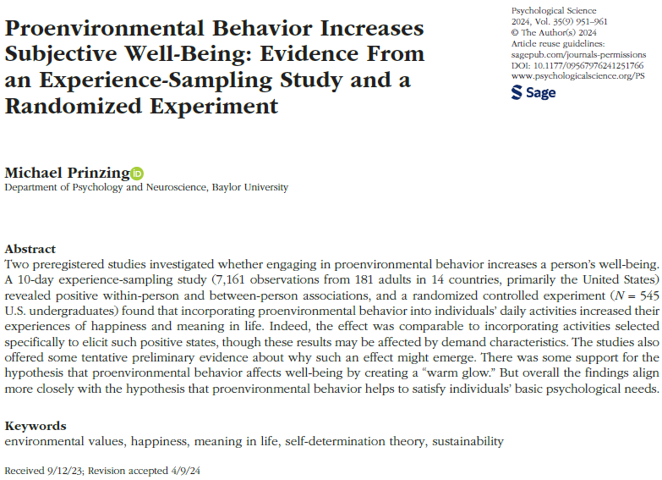

Slide 3
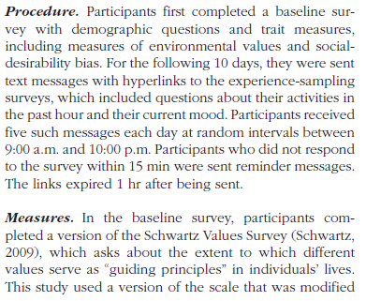
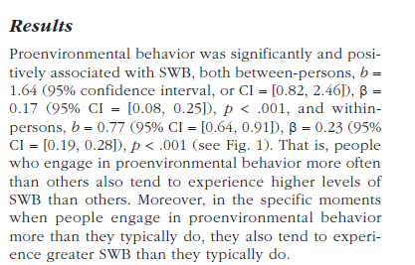
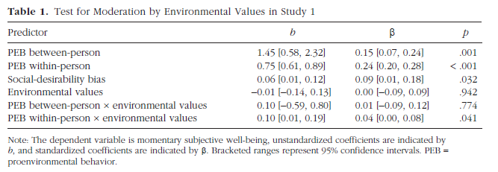
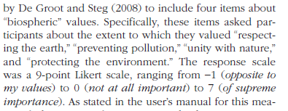


Slide 4
Exp 2
Participants in the control condition were given a neutral task: “Tomorrow, we would like you to keep track of your activities. You do not need to remember who you were with or how you were feeling during that time. Instead, just try to remember factual information about what you are doing. Do not alter your routine. Simply keep track of what you do.”
Participants in the proenvironmental behavior condition received the following instructions: “In our daily lives, we all make choices that affect the environment. Tomorrow, your task is to do three good things for the planet, all three in one day.” We gave a list of example behaviors, including some that would be easy for young adults to implement on any particular day (e.g., “Walk, bike, or take public transportation instead of driving” or “Find a new recipe that uses vegetarian or locally produced ingredients”)…
Participants in the fun condition received the following instructions: “In our daily lives, we all perform acts of kindness for others, but we often neglect to do nice things for ourselves. Tomorrow, your task is to do three good things for yourself, all three in one day.” We again gave examples (e.g., “Relax in a bath or hot tub” and “Spend some time on a hobby”) and told participants that, although they could do whatever they liked, they should choose activities that they would not typically do for themselves.
Two days later, participants returned for follow-up. They first completed SWB measures and afterward described in their own words what they had done on the previous day.

Slide 5
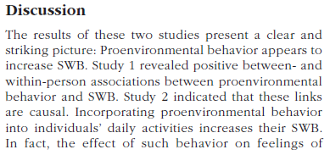
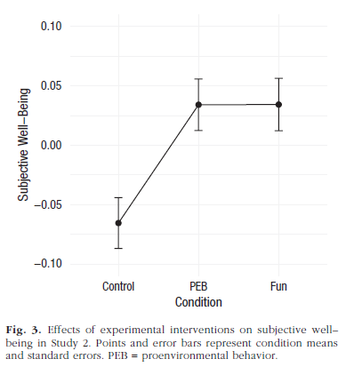


Slide 6
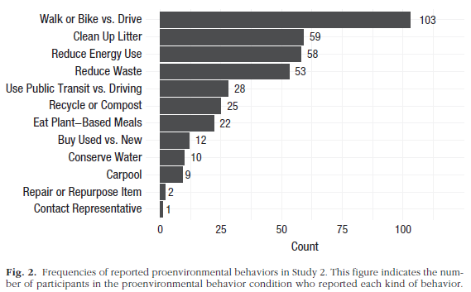
Open-ended questions
Two days later, participants returned for follow-up. They first completed SWB measures and afterward described in their own words what they had done on the previous day.
We content-coded the responses to the open-ended question in order to catalog the kinds of proenvironmental behaviors that participants chose to engage in.
  N = 545
  37 excluded for lack of engagement

Slide 7
Chapter 16 Assignment
Q1. A colleague helping with a research project comes to tell us in that the latest statistical analysis, they found an r = 2.30? Should we be excited?
Q2. A college administrator is choosing between 2 admissions tests, one that correlates with subsequent college performance r = -.54, and one for which, r = +.45. Which test should be preferred and why?

Slide 8
Q3. Of all the statistical tests we have covered in class so far, explain which is appropriate for each of the following hypothetical designs and why:
  Older people (age in years) are found to exercise less (in hours per week) than middle aged people
  At a car dealership, people planning to buy a car are either shown a documentary on climate change or not and then they are scored as to whether they purchased an electric vehicle or gas vehicle
  Hospitalization rate (percent of people hospitalized) due to COVID infection differ in counties that voted red (Republican) or blue (Democrat) in the 2020 election
  The relationship of first year salary post-graduation with average GPA in sophomore year during college
  Number of social media posts made by people who either took research methods in college or did not
  An analysis of scores on the Oxford Happiness Scale based on participants diet (vegetarian/not) and whether they have a Facebook account.

Slide 9
Brief History of Psychology
Introspection
  1890, William James
  Subjective reflection
Behaviorism
  1930, BF Skinner
  Quantitative measures, animals
Cognitive Revolution
  1960, George Miller 7+2
  Quantitative measures, humans
Moden Methods
  Cognitive Neuroscience, 1990-
  Quantitative measures, neuroscience and physiology, humans

Slide 10
Observation as a Method
Watching the behavior of people around you
  Old-fashioned method for developing ideas
  “Didja ever notice how…?”
Social media studies
Diary studies

Slide 11
Interviews
Methods borrowed from Sociology, Anthropology
Collect stories of personal experience
  Anecdotes are not data but they are illustrative
  Insight into cross-cultural differences

Slide 12
Quantifying Qualitative data
Structured interviews
  Protocol for interview procedures
Coding systems
  Count occurrences of words, ideas
  Calculated relationship among measures
Verbal protocol analysis
  Talking out loud during problem solving

Slide 13
Chapter 17
Qualitative research is often used in a research program as a first or preliminary study before research with experimental methods and manipulated variables. Why is this?
Why might we use a qualitative research technique to study parent-child interactions and aggressive behavior in preschoolers? Outline what such a study might look like.
In a diary study of conflict resolution in relationships, the research protocol could involve daily documentation of any conflict experiences and how they were or were not resolved. What kinds of events might be coded for and counted in a study of this type?

Slide 14
Quasi-experimental design
Case study research
  Telling the stories of notable individual cases
  Developmental cases
  Clinical cases
  Neuropsychological studies
Field research
  Applying experimental methods outside the lab
  Chapter 19

Slide 15
For Wed 11/13
Chapter 18: Responsible Conduct of Research
  Assignment on Canvas
Final projects
  Start putting your procedure together for our review

